Slide 1
Laguna Joint & Lincoln Union School Districts
PUBLIC hearing on Proposed Reorganization
february 9, 2021

Slide 2
January 2021
Laguna Joint
School District
2657 Chileno Valley Road
Petaluma, CA 94952
707/762-6057
To Laguna Joint and Lincoln Union School Districts Communities:
As related in the fall, after more than a century of providing quality education to many
generations of children in the areas surrounding our three rural schools - Laguna, Lincoln and Union - we have evaluated the options which will allow our two districts to sustainably
continue. Due to changing demographics and budget dictates from the state, the Boards of
Trustees of our two Districts, with input from our communities, have concluded that merging the districts is in the best interests of our students, parents and landowners.
After receiving positive community input at special meetings to address restructuring, our
two school boards began the process to merge the two school districts. The proposed plan
allows both schools to remain open and continue to serve the needs of our students and
communities. The proposed new district will also have the option to use Union School in the future. Our two districts do not presently have any Bonding, Parcel Taxes or other forms of taxation and this merger will not have any impact on that status.
Lincoln Union School District
1300 Hicks Valley Road
Petaluma, CA 94952
707/763-0045

Slide 3
Our two Boards are soliciting suggestions from our communities regarding
  Name for the new district,
  Makeup of the new board of trustees,
  Sustainability, and
  Any other issues you feel need to be addressed.
To facilitate this communication, we have scheduled a public hearing during our regular school board meetings on February 9, 2021 at 6:30 pm at Laguna School and 3:30 pm at Lincoln School.
Due to COVID-19 issues, both meetings will be conducted online.

Slide 4
Background
Reorganization of the Lincoln Union and laguna joint school districts

Slide 8
Reorganization plan
Reorganization of the Lincoln Union and laguna joint school districts

Slide 9
Reorganization plan process
The reorganization will be implemented through the lapsation of Lincoln Union school district into Laguna Joint school district
Public hearings were held in both Lincoln Union and Laguna Joint in September to gain public input on a potential reorganization subsequent to which both boards passed resolutions of the intent to reorganize into a single district.
Following the Public hearings being held today at both Lincoln Union and Laguna Joint school districts regular board meetings, the boards intend to take action by resolution at the regularly scheduled board meetings in March to detail the reorganization plan.
Both resolutions will be forwarded to the County Committee on School District Organization to evidence both districts support for the lapsation of Lincoln Union into Laguna Joint school district.

Slide 10
Reorganization plan process
The County Committee on School District Organization is charged by Education Code to hold a public hearing regarding the pending lapse of Lincoln Union within 45 days before the close of the school year.
At a meeting subsequent to the public hearing, and at least 30 days before the end of the school year, the County Committee will consider action to lapse Lincoln Union’s territory into a contiguous district.
The timing requirements outlined in education code (35782 and 35783) require that both meetings be held within the period May 17, 2021 through May 21, 2021.
The boards of both districts plan to attend both meetings.

Slide 11
Draft Reorganization Plan - Laguna
REORGANIZATION PLAN – DRAFT RESOLUTION - LAGUNA
WHEREAS, the Lincoln Union School District (Lincoln Union) and the Laguna Joint School District (Laguna) have affirmed their respective intent to partner with each other in a reorganization to take effect on July 1, 2021; and
WHEREAS, the reorganization will be implemented by the lapsation of Lincoln Union into Laguna, whereby the Laguna board will become the governing board for the entire territory; and
WHEREAS, Laguna and Lincoln Union formed a reorganization subcommittee appointing Dan Hess from Laguna and Jim Grossi from Lincoln Union to represent their respective boards; and
WHEREAS, the reorganization subcommittee has met monthly to address aspects of the reorganization including the process itself, the membership of the board, board policies, the name of the district, personnel – salary and seniority considerations, real property, joint powers agreements and outstanding liabilities and has reported back to respective boards to facilitate the development of a reorganization plan; and
WHEREAS, Lincoln Union and Laguna notified their respective public of public hearings held in each district on February 9, 2021 to guide both governing boards in the development of the reorganization plan; and
THEREFORE, be it resolved, the Laguna Joint School District does hereby confirm its intent to hold a newspaper published public hearing in March 2021 for the purpose of soliciting public input on expanding the size of the board from three members to five members with a waiver of the Education Code requiring an election; and
THEREFORE, be it resolved, upon approval of the aforementioned waiver by the State Board of Education, the Laguna Joint School District does hereby confirm its intent to notice the public of the resulting vacancies on the board with the intent to appoint applicants to the Board no later than August 2021; and

Slide 12
Draft Reorganization Plan - Laguna
THEREFORE, be it resolved, the Laguna Joint School District does hereby affirm the longstanding collaboration between the Lincoln, Union and Laguna communities and welcomes the opportunity to consider a petition to rename the District to better reflect all three communities; and
THEREFORE, be it resolved, the Laguna Joint School District does hereby confirm its commitment to adopting board policies as necessary to facilitate the smooth transition to a single district operating two school sites; and
THEREFORE, be it resolved, the Laguna Joint School District has determined current salary schedules offer incoming staff from Lincoln Union the same or even a slightly higher salary and that Laguna’s benefit offerings are identical to those at Lincoln Union; and
THEREFORE, be it resolved, the Laguna Joint School District will ensure that all actions necessary to complete the reorganization including the transfer of real property, will be undertaken in a timely manner with regular updates provided to the board; and
THEREFORE, be it resolved, the Laguna Joint School District hereby commits to performing all necessary actions to expeditiously add Lincoln Union real property and equipment to insurance coverage with the Marin Schools Insurance Authority, a joint powers authority; and
THEREFORE, be it resolved, the Laguna Joint School District confirms it does not currently hold any long term liabilities outside of the allocation of the District’s proportionate share of the unfunded liability for retirement benefits; and
THEREFORE, be it resolved, the Laguna Joint School District has examined all issues relevant to receiving the Lincoln Union school district and hereby affirms its commitment to becoming the receiving district in a school district reorganization lapsing the Lincoln Union School District to take effect on July 1, 2021 pending confirmation by the Marin County Committee on School District Organization

Slide 13
Draft Reorganization Plan – Lincoln Union
REORGANIZATION PLAN – DRAFT RESOLUTION LINCOLN UNION
WHEREAS, the Lincoln Union School District (Lincoln Union) and the Laguna Joint School District (Laguna) have affirmed their respective intent to partner with each other in a reorganization to take effect on July 1, 2021; and
WHEREAS, the reorganization will be implemented by the lapsation of Lincoln Union into Laguna, whereby the Laguna board will become the governing board for the entire territory; and
WHEREAS, Laguna and Lincoln Union formed a reorganization subcommittee appointing Dan Hess from Laguna and Jim Grossi from Lincoln Union to represent their respective boards; and
WHEREAS, the reorganization subcommittee has met monthly to address aspects of the reorganization including the process itself, the membership of the board, board policies, the name of the district, personnel – salary and seniority considerations, real property, joint powers agreements and outstanding liabilities and has reported back to respective boards to facilitate the development of a reorganization plan; and
WHEREAS, Lincoln Union and Laguna notified their respective public of public hearings held in each district on February 9, 2021 to guide both governing boards in the development of the reorganization plan; and
THEREFORE, be it resolved, the Lincoln Union School District does hereby affirm its support of Laguna Joint School District’s intent to take the actions necessary to expand the size of the Laguna Joint board from three members to five members with a waiver of the Education Code requiring an election; and

Slide 14
Draft Reorganization Plan – Lincoln Union
THEREFORE, be it resolved, the Lincoln Union School District in acknowledging the longstanding collaboration between the Lincoln, Union and Laguna communities does hereby affirm its support for changing Laguna Joint school district’s name subsequent to the reorganization to better reflect all three communities; and
THEREFORE, be it resolved, the Lincoln Union School District has determined current salary schedules at Laguna Joint School District offer Lincoln Union staff members the same or even a slightly higher salary and that Laguna’s benefit offerings are identical to those at Lincoln Union; and
THEREFORE, be it resolved, the Lincoln Union School District confirms it does not currently hold any long term liabilities outside of the allocation of the District’s proportionate share of the unfunded liability for retirement benefits; and
THEREFORE, be it resolved, the Lincoln Union School District has examined all issues relevant to lapsing and hereby confirms it is in support of being received by the Laguna Joint school district in a school district reorganization lapsing the Lincoln Union School District to take effect on July 1, 2021 pending confirmation by the Marin County Committee on School District Organization.

Slide 15
District Naming
Reorganization of the Lincoln Union and laguna joint school districts

Slide 16
School District Renaming
To rename the Laguna Joint Elementary School District after the reorganization, a petition would need to be presented to the Laguna Board following which the Laguna Board would need to hold a public hearing (published in a newspaper at least twice before the hearing). The Laguna Board would then take action subsequent to the hearing and notify the county elections officials in both Marin and Sonoma Counties of the name change.
Renaming impacts the District name only. The three schools would remain unchanged as Laguna, Lincoln, and Union.
The reorganization committee has identified a timeline for the renaming to occur as soon as practicable subsequent to the reorganization which would require receipt of a petition in July 2021 for public hearing and action in August 2021. This timeline is not dictated by education code as renaming can be initiated at any time with the generation of a petition. The following education code section governs the renaming process:

Slide 17
School District Renaming
Education Code Section 35000
(a) Whenever a petition is presented to the governing board of a school district, signed by at least 15 qualified electors of that school district, asking that the name of the district be changed and stating the new name requested, the governing board shall designate a day upon which it will act upon the petition, which shall not be less than 10 days nor more than 40 days after the receipt of the petition.
  The governing board shall give or cause to be given notice to all parties interested by publication in a newspaper published within the school district, or, if there is none, in any newspaper published in the county, of the time set for the hearing of the petition. The notice shall be published at least twice before the day set for hearing. At the hearing the board shall by resolution either grant or deny the petition, and, if granted, shall notify the county superintendent of schools of the change of the name of the district. The board shall also certify the name change to the county elections official of each county in which any part of the school district is situated. The name change shall also be entered in the records of the governing board.

Slide 18
School District Renaming – Proposed timeline of actions

Slide 19
Board membership
Reorganization of the Lincoln Union and laguna joint school districts

Slide 20
Board membership
The boards have determined that to ensure full and ongoing representation from all three communities – Laguna, Lincoln, and Union, it would be desirable to have a larger board for Laguna Joint district subsequent to the lapsation action expanding territory to include the Lincoln-Union boundaries. Education code allows for expansion to five members by the boards own action (i.e. action by resolution), however, would normally then require the new seats be filled at the next regularly scheduled election. The California Department of Education have advised that the board (Laguna) would be able to request a waiver of certain elements of education code and utilize the code section directing the board to appoint members to the new seats.
The decision to request a waiver of the election is based on the fact that both districts have a long history of uncontested elections and an election would, therefore, likely be an unnecessary expense. When combined with other elections, the County of Marin charges approximately $2 per voter to recoup the costs associated with the election.

Slide 21
Board membership
To accomplish this, the Laguna Joint board would need to hold a newspaper published public hearing in March 2021 followed by action taken at the April 2021 meeting to allow submission of the waiver request to CDE by the deadline of April 20th to be placed on the July 14-15, 2021 State Board of Education board meeting agenda. The Board would then be able to appoint members to the new seats at their next meeting. We would recommend setting a meeting to appoint new members in August 2021. The timeline has been updated to reflect these actions.

Slide 22
School District Renaming
Laguna Joint School District Board Membership and terms
Terms for members of expanded board to be appointed in August 2021 (*awaiting legal review)
Member | Title | Term
Daniel Hess | President | December 2022
Sharon Baretta Hess | Member | December 2022
Jim Lanatti | Secretary | December 2024
To be appointed | Member | *December 2022
To be appointed | Member | *December 2024

Slide 23
Board membership – proposed process to expand from three to five members

Slide 24
Sustainability
Reorganization of the Lincoln Union and laguna joint school districts

Slide 25
Sustainability
The lapsation of Lincoln Union School District into Laguna Joint School District is intended to resolve the two main issues underlying the districts’ near-term sustainability:
  Student Enrollment
  To avoid lapsation the District as a whole must maintain a minimum of six units of average daily attendance in grades one through six.
  Fiscal Solvency
      Combining the two Districts brings a certain economy to expenditures, primarily by reducing administrative overhead costs, however, does not eliminate deficit spending. The district will be able to operate two school sites for some time due to healthy fund balance reserves. Long term sustainability will need additional solutions, which could include operating a single site and, dependent on budget conditions, thereby replenishing reserves.

Slide 26
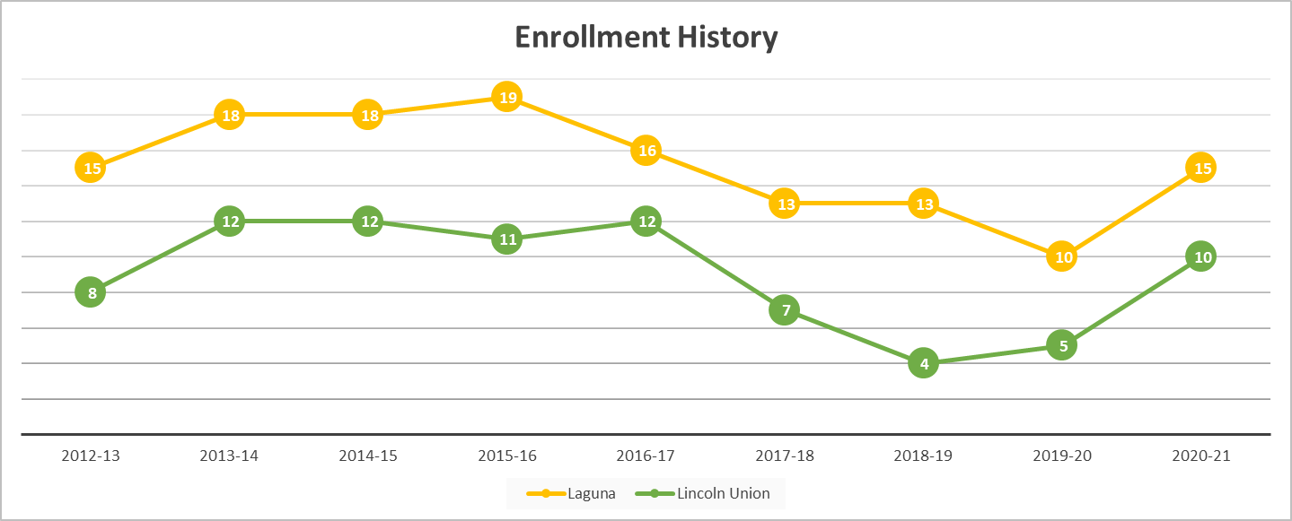
Student Enrollment

Slide 27
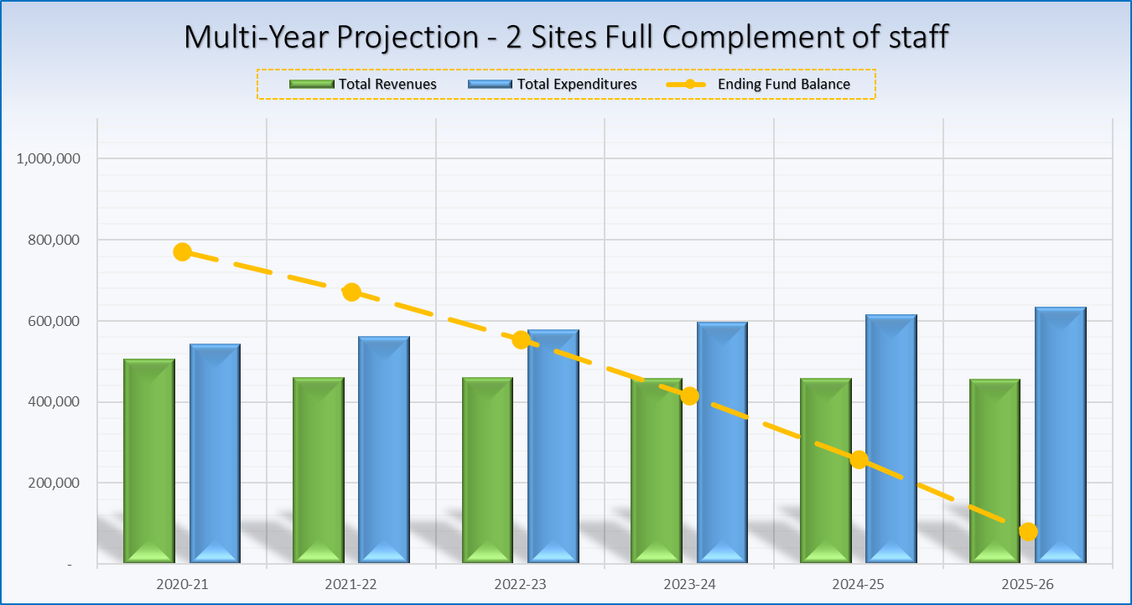
Operating two schools after reorganization
Staffing pattern of 1 teacher, 1 aide and professional experts at each site

Slide 28
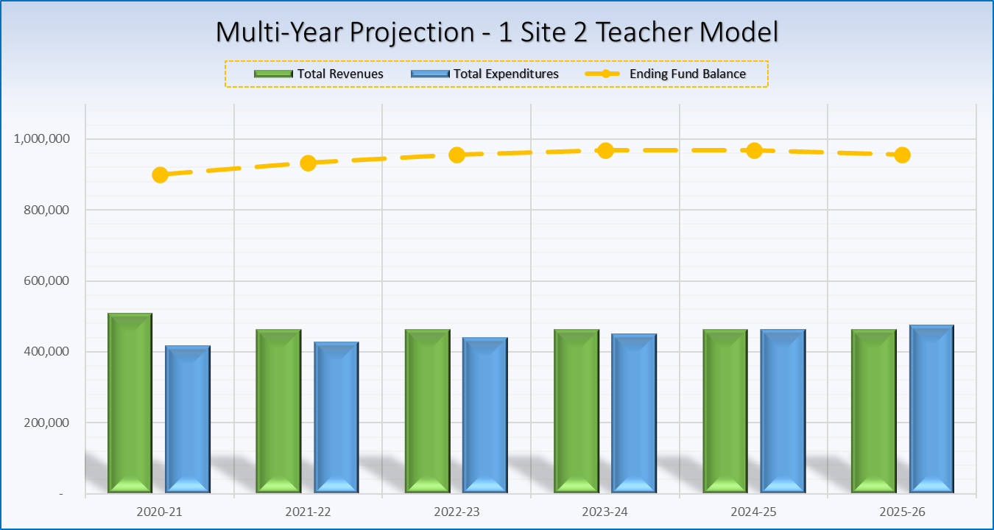
Operating one school after reorganization
Staffing pattern of 2 teachers and professional experts at a single site

Slide 29

QUESTIONS AND COMMENTS
Please type your question or comment into the chat box or use the tools to raise your hand to speak

